Slide 1



Satellite Insights For Sustainable Farming
Leveraging AI and Remote Sensing to Empower Small Farms

Slide 2
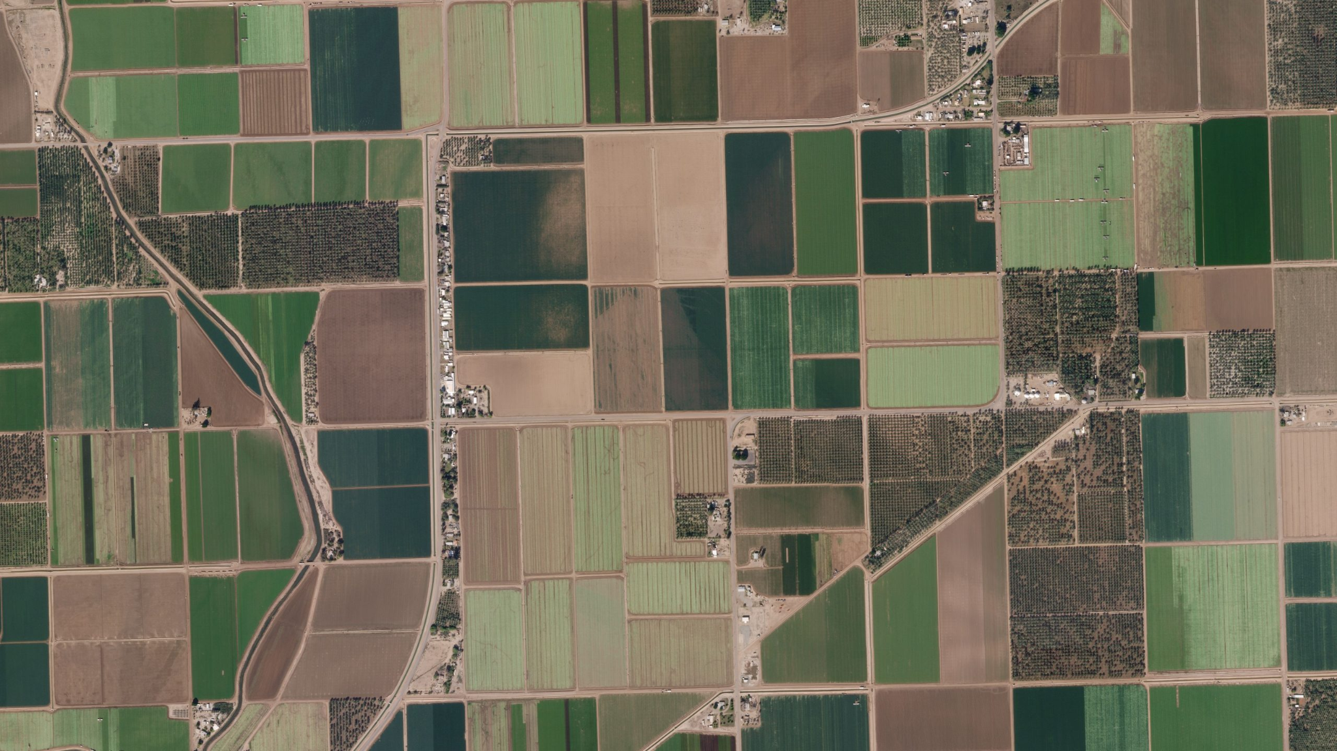
Mission Statement: Democratize Access to precision agriculture via AI and Remote Sensing Data.

Slide 3
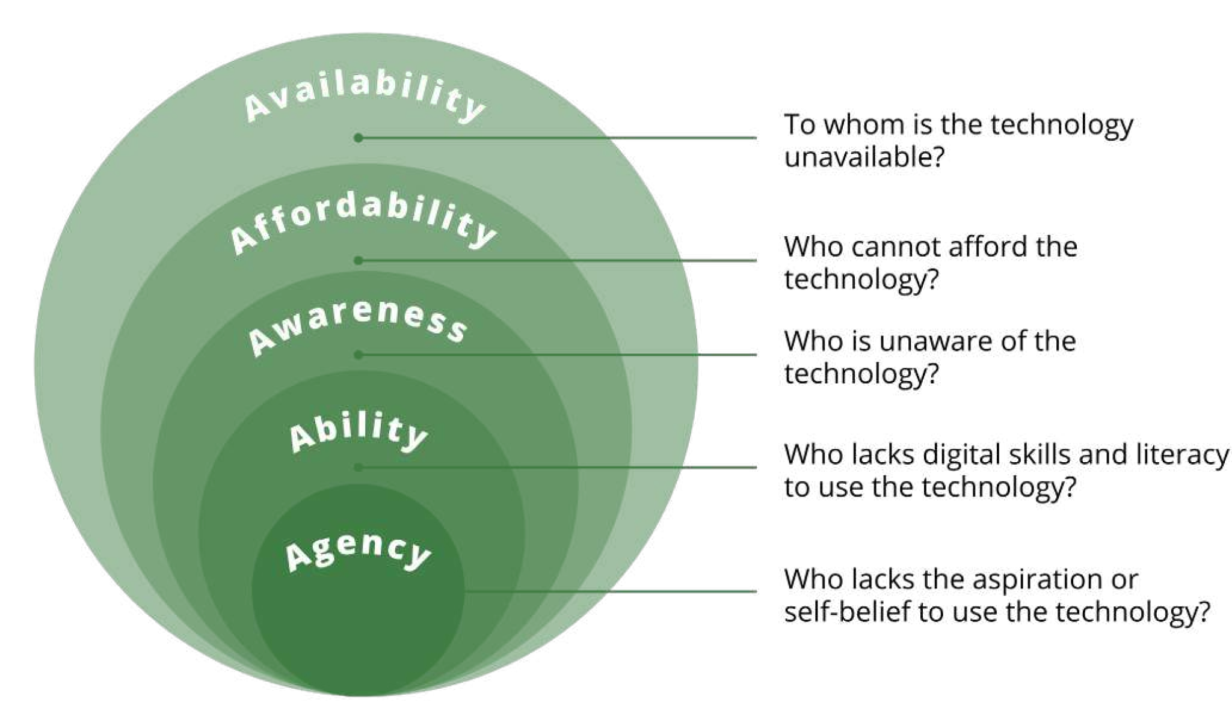
The Problem
24% of farm land and 90% of farmers worldwide are smallholder.
Smallholder farmers suffer from low productivity and yields and lack access to technology.
Agriculture is a major contributor to the climate crisis and is also impacted by it.

Slide 4
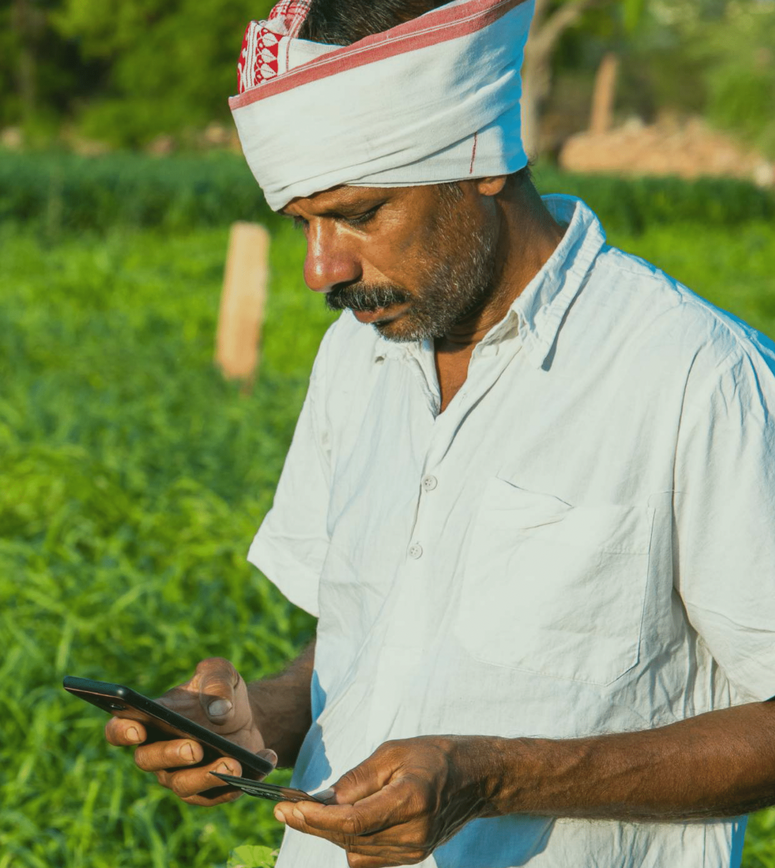
The Solution
Precision Agriculture: Data and Technology for simpler, more efficient, and more productive farming.
Data: Satellites to provide snapshots of large area of farmlands.
Technology: AI to analyse the imagery for crop health monitoring and yield estimation for individual farms

Slide 5


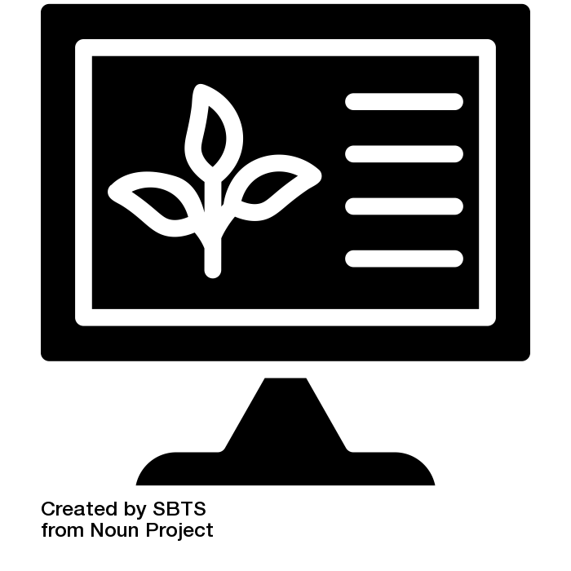
How it works
3. Insights
2. Montoir
1.Sign up
Use paid API to get insights into yield estimation.
Get continuous and historical status monitoring
The farmer signs up and upload the farms information

Slide 6
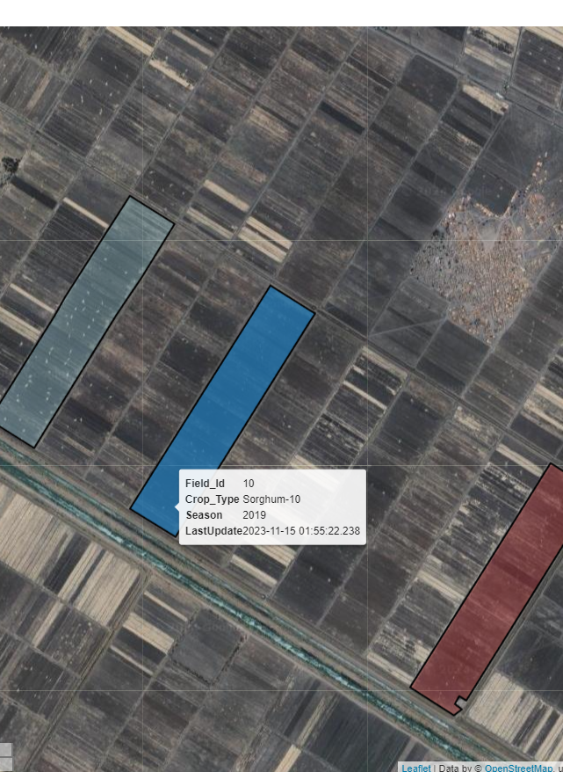
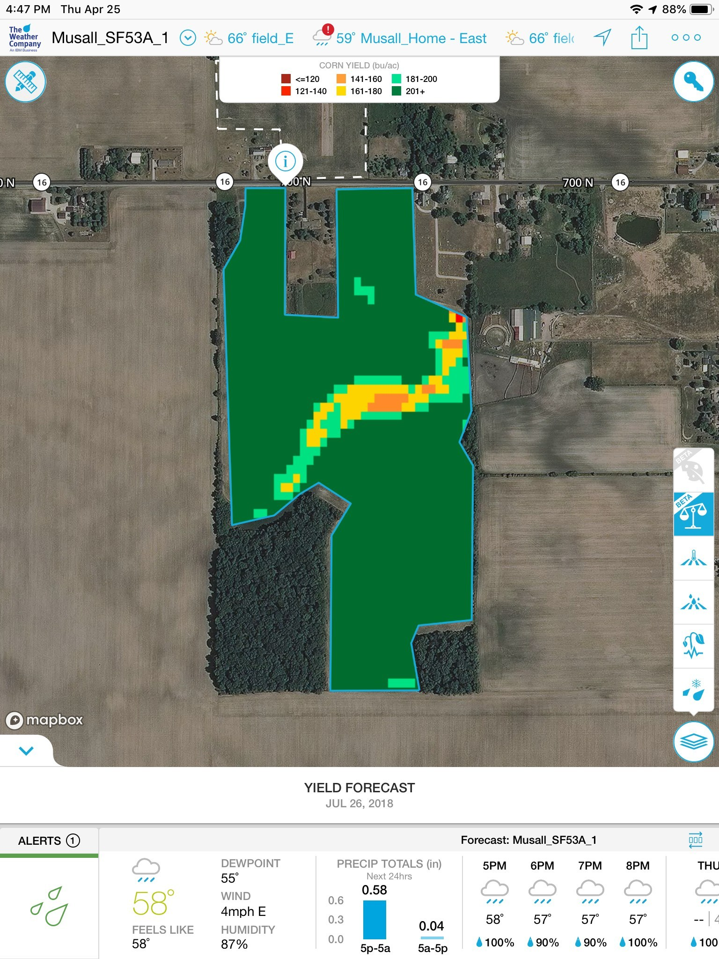
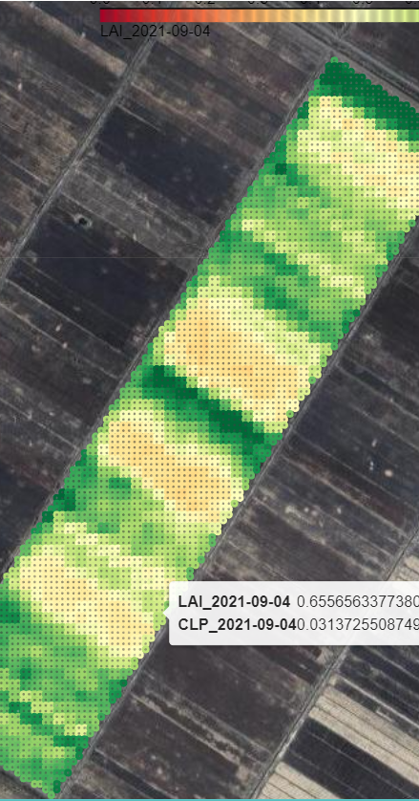
How it works

Slide 7




The Team
Ammar
Mukhtar
Mohamed Yahia
Someone Else ?
Team Lead, Geospatial Analyst, ML
Member, DevOps Engineer
Member, Machine Learning Engineer
Depending on the project needs

Slide 8
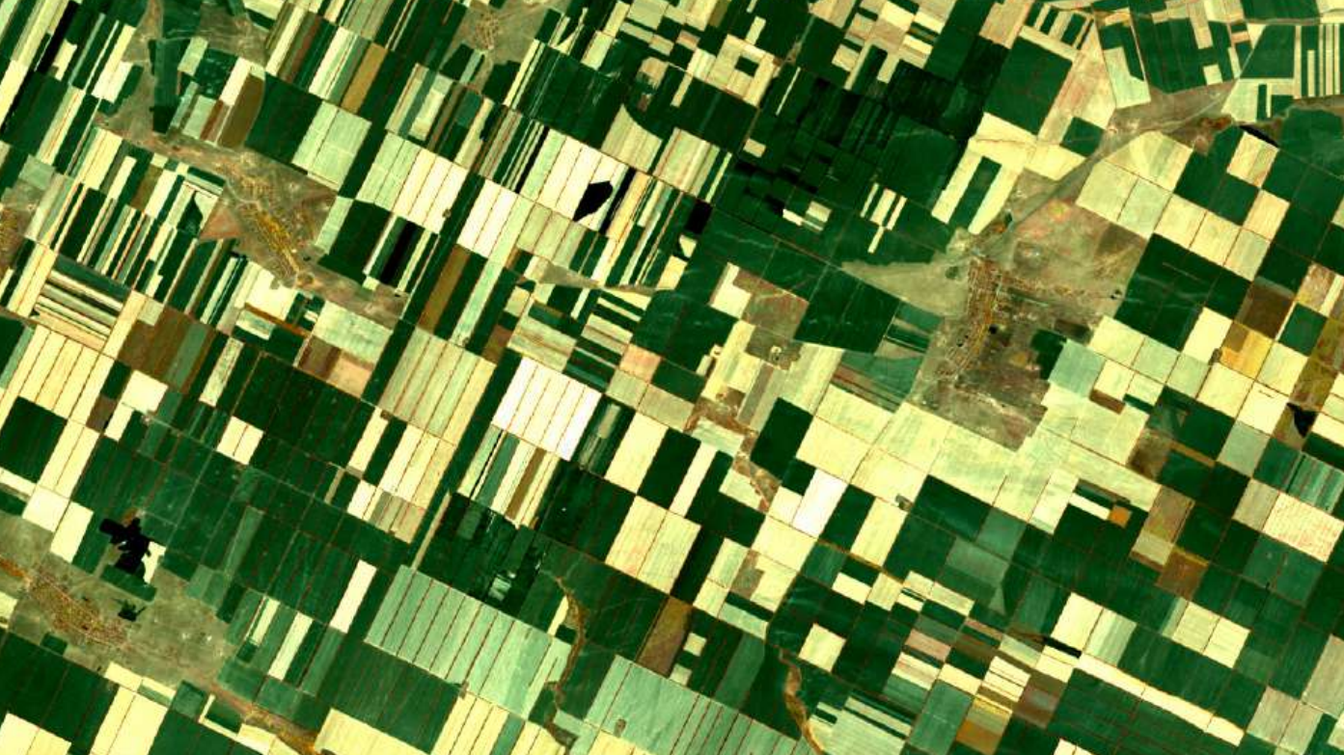
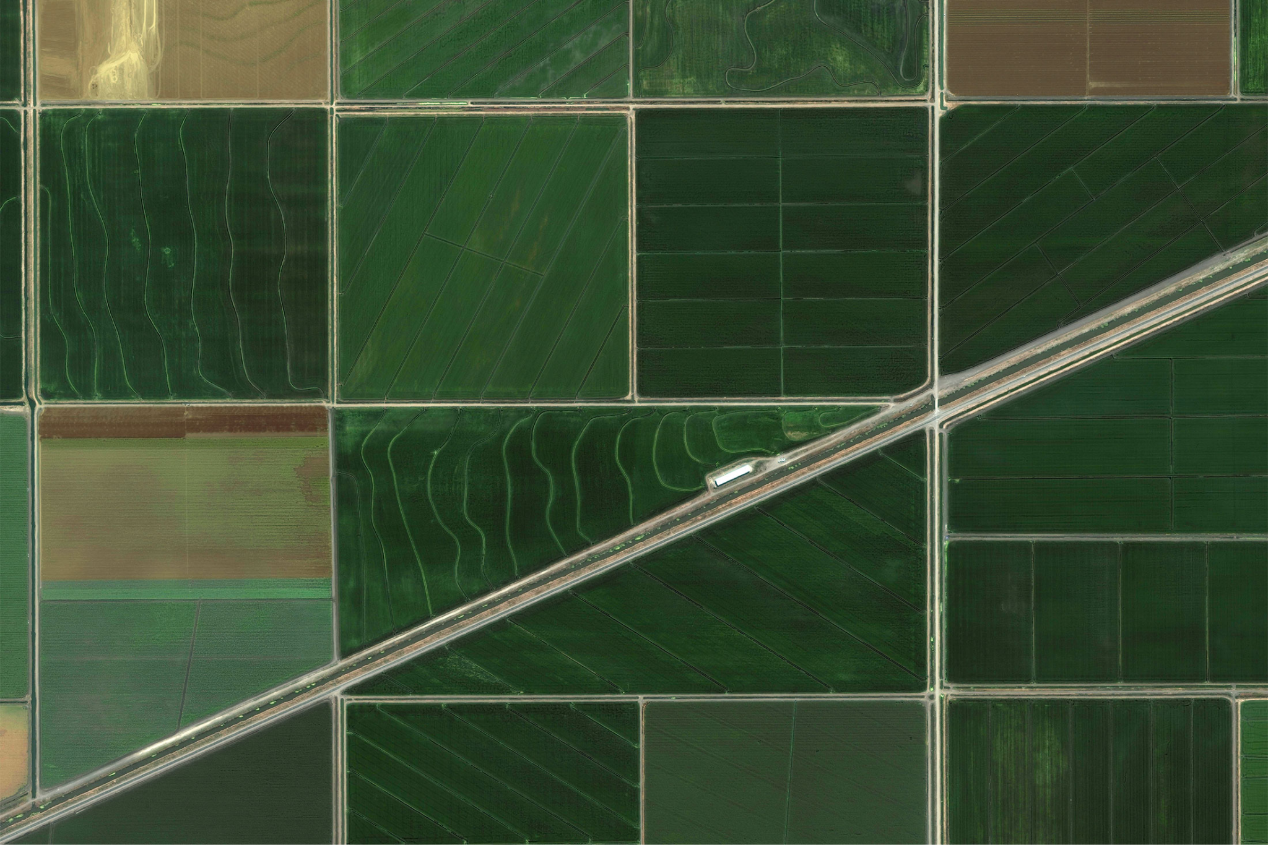
Thanks
Questions ?

Slide 9
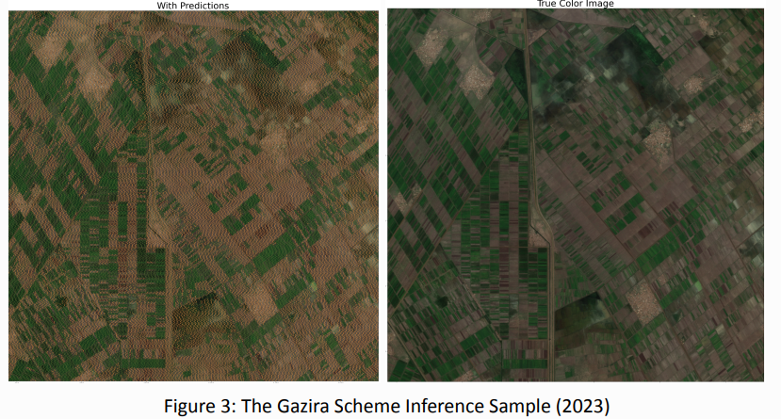
Appendix

Slide 10
Our Plan
Monitoring Dashboard
Data & Model Pipelines
Onboarding & CI/CD
Modular, Simple & Cost Effective. We use open source tool whenever possible (access to Sentinel-2 API is paid) and keep our work open sourced.

Slide 11
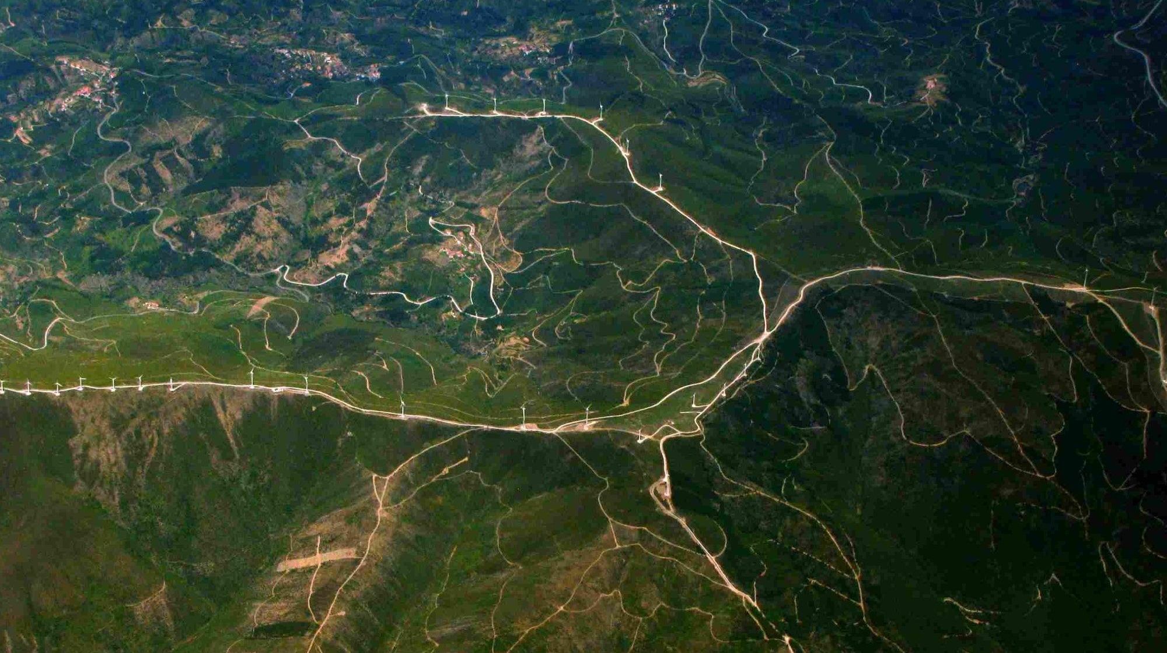
Impact ?
Our Target audience is responsible for a THIRD of all the agricultural output worldwide, according to FAO

